Slide 1



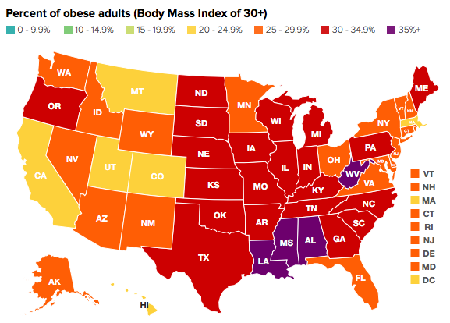
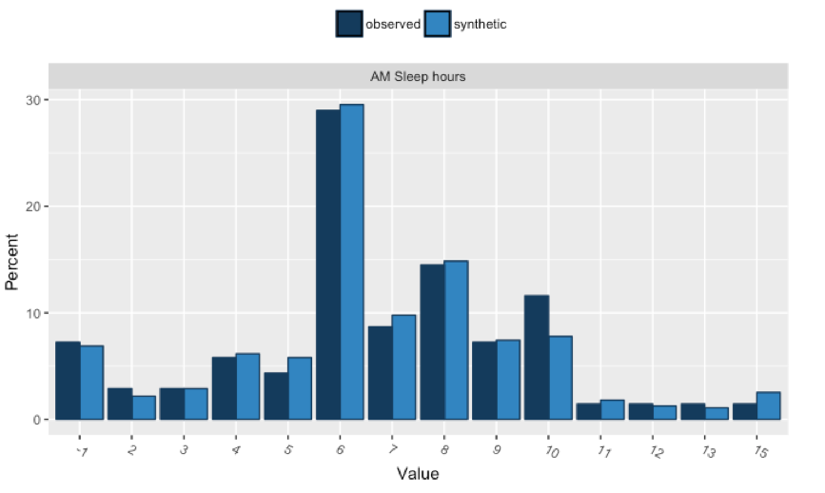
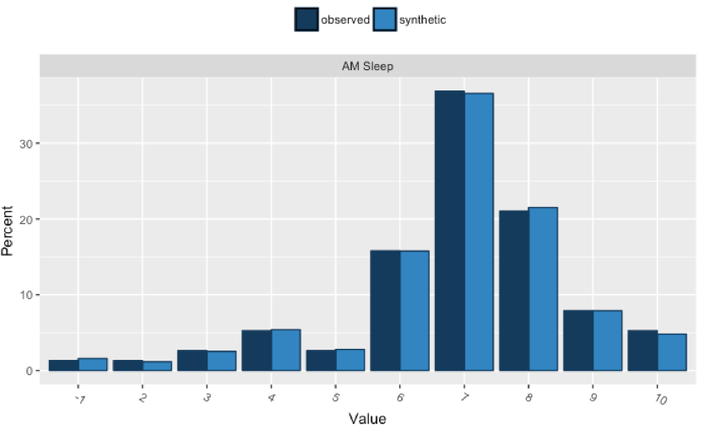
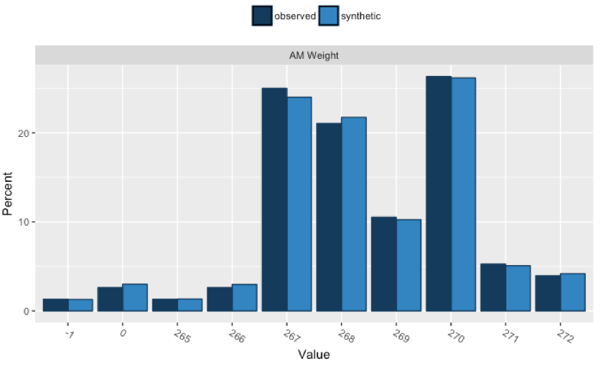
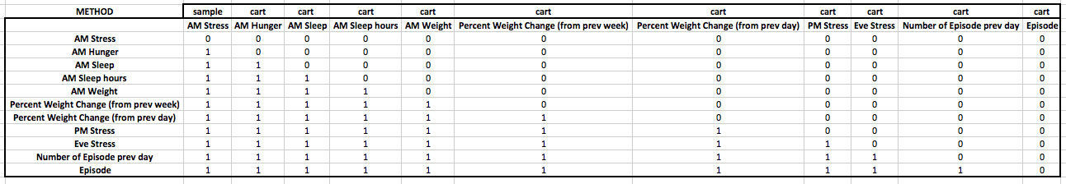
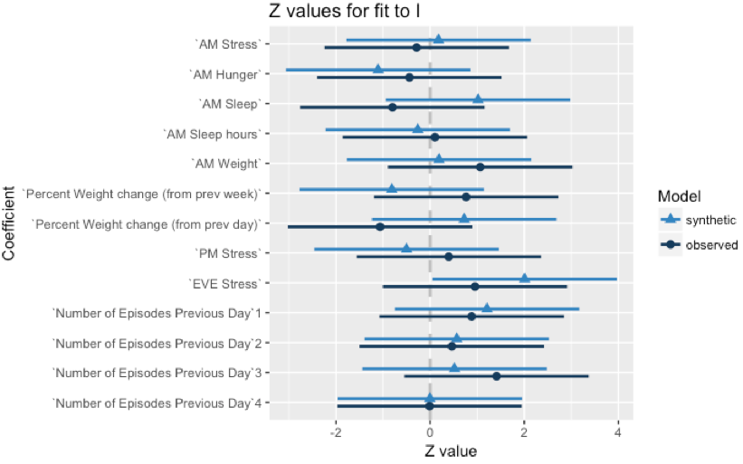
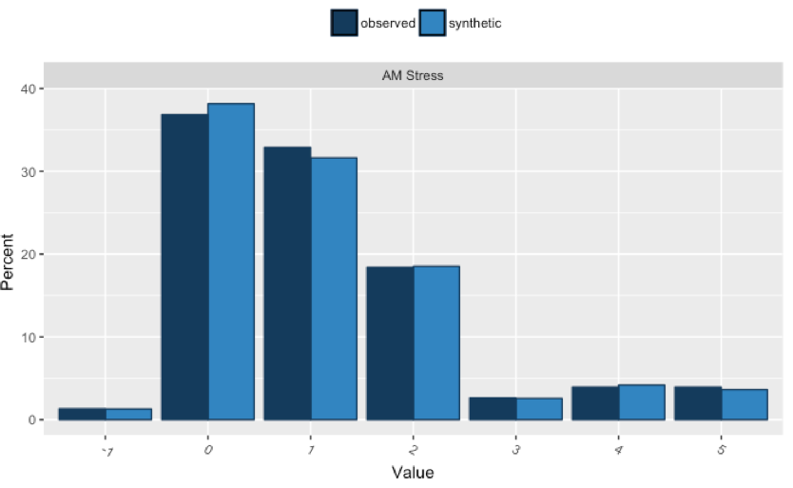
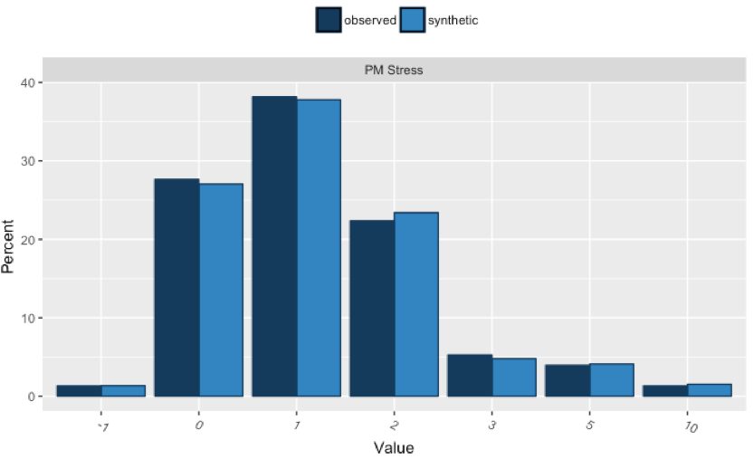
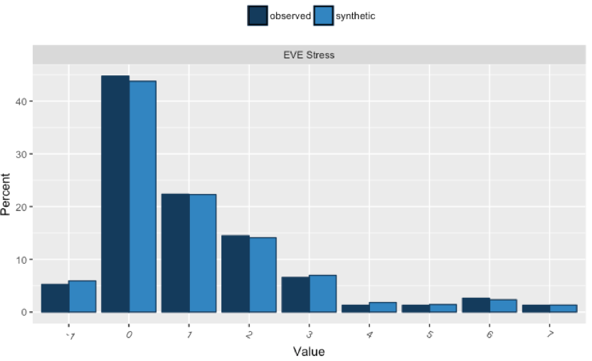

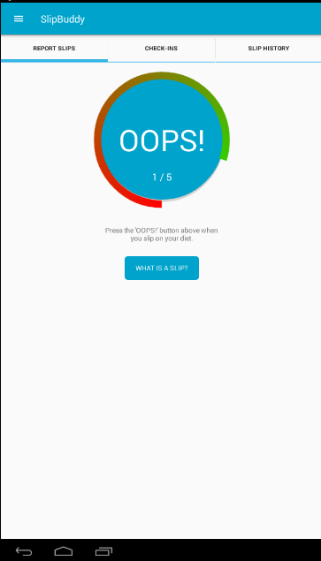
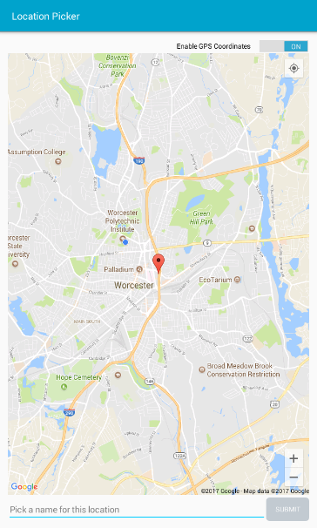
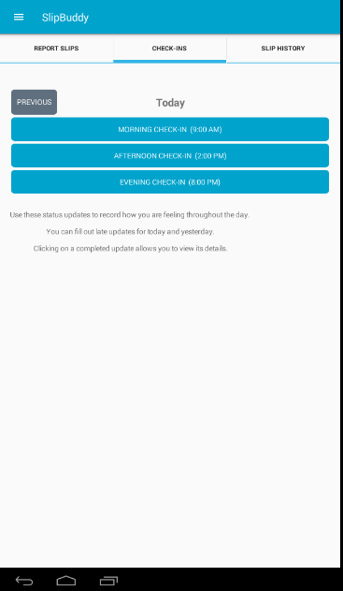


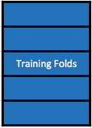
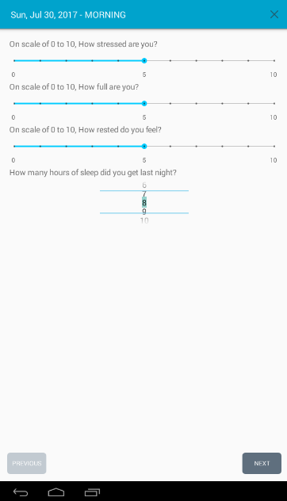


Distributed Local Outlier Detection in Big Data Khang Vinh Tran (UC Berkeley / De Anza College) Worcester Polytechnic Institute Advisor: Carolina Ruiz (WPI) – Co-Researchers: Katherine Finnerty (Amherst College), Quyen Hoang (WPI)
Information
Synthetic Data Generation
SlipBuddy
Cross-Validation with Decision Tree and K Nearest Neighbors
Design
Hypothesis Testing – Conclusion
Future Work
References
Acknowledgement
This research was funded by the National Science Foundation (NSF) through the REU SITE: Data science research for safe, sustainable and healthy communities (CNS – 1560229)

